Slide 1
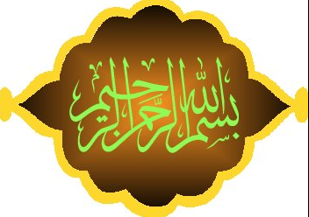

Slide 2

PROJECT TEAMWORK
Notes:
The incidence of both lower incomes due to economic crisis and persistent high food prices has proved to be a devastating combination for the world’s most vulnerable populations.

Slide 3
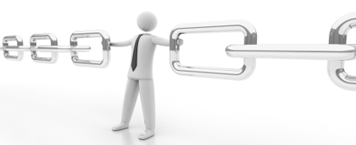

“A chain is only as strong as its weakest link”
“So a team is as strong as its weakest member”
A single problematic member will have a dangerous effect on the strength of the entire team

Slide 4
Salient topics
Project Team and Teamwork
Stages of Team Development
Issues in Teamwork
Remedies of Issues
Conclusion

Slide 5
Team and Teamwork
Team
A group of PEOPLE
with a full set of complementary SKILLS
required to complete a TASK, JOB, or PROJECT
Each member is having more than one skills

Slide 6
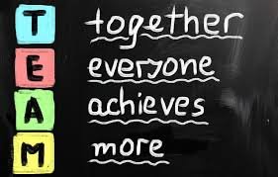
Team and Teamwork
Team
A team becomes more than just a COLLECTION OF PEOPLE ...
... when a strong sense of MUTUAL COMMITMENT creates synergy ...
... thus generating PERFORMANCE greater than the sum of the performance of its individual members

Slide 7
Team and Teamwork
Team Members
Operate with a high degree of INTERDEPENDENCE
Share authority & responsibility for
SELF-MANAGEMENT
Are accountable for the
COLLECTIVE PERFORMANCE
Work towards a
COMMON GOAL and SHARED REWARDS

Slide 8



Team and Teamwork
Teamwork
The process of Working Collaboratively with a group of people in order to achieve a goal
Teamwork is often necessary for colleagues to work well together, Trying Their Best in any circumstance
People try to cooperate, using their Individual Skills and providing Constructive Feedback, despite any personal conflict between individuals

Slide 9
Stages of Team Development
Forming
Every team has to pass through these stages in order to GROW to the point where it functions EFFECTIVELY in unison and deliver high quality RESULTS
Storming
Norming
Performing
Adjourning

Slide 10
Stages of Team Development
Stage 1 - Forming
It is a situation that members of a group don’t truly understand about their duty, regulations and rules
The members cannot finish their job without leader or manager due to lack of confidence
They have to be encouraged and motivated by the leader so they feel as a significant part of a team

Slide 11
Stages of Team Development
Stage 2 - Storming
It is a situation that often starts when team members prefer to use conflicting work styles
People may work in different ways, but if it causes unforeseen problems, they may become frustrated
Team leader should help all members to accept each other and respect in each individual task

Slide 12
Stages of Team Development
Stage 3 - Norming
This stage is a period when team members know one-another better
They socialize together, and are able to ask each other for help and provide constructive feedback
At this point the leader needs to provide a delegate for making agreement and consensus

Slide 13
Stages of Team Development
Stage 4 - Performing
This is a stage where all members can achieve the task without any problems
But they want to develop the team with regard to interpersonal development
The leader should concentrate on developing performance of the team
This is the last stage for permanent groups

Slide 14
Stages of Team Development
Stage 5 - Adjourning
It is the final task when especially a group is successful
This stage helps increase motivation of members to move on to another task
The team must be appreciated by the leader with the achievement
This stage is for temporary groups; permanent group have only four stages.

Slide 15
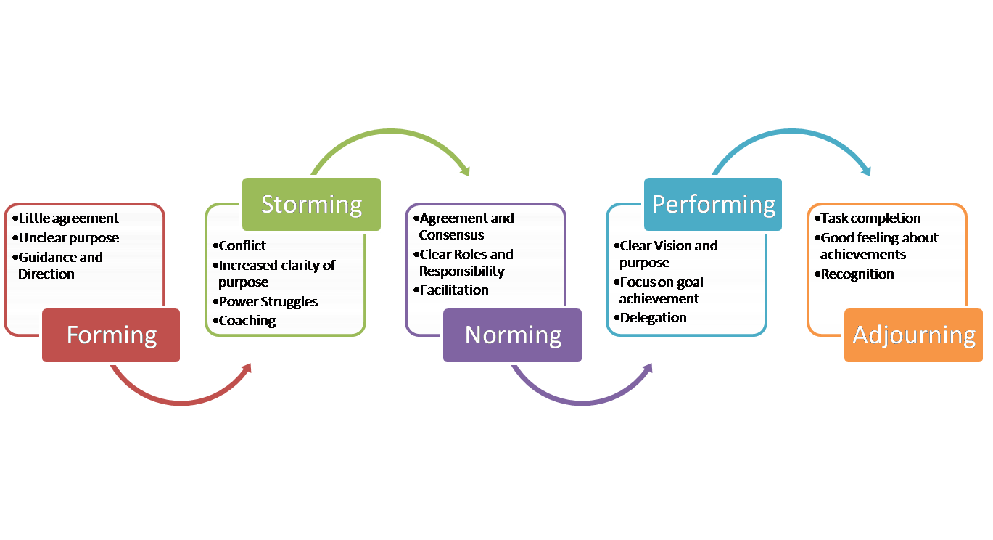
Stages of Team Development

Slide 16
Issues in Teamwork – Causes
Most of the issues arise in first two stages – i.e. during FORMING and STORMING primarily depends upon
Type Of Leadership
Leadership that does not address these issues timely and amicably, fails to move on to further stages of
Effectiveness → Increased Productivity
The incompetent leaders keep on taking the steps for task accomplishment but with
Immense Drag → 26 Teamwork Key Issues

Slide 17
Project Team Issues
1. Absence of team identity
2. Difficulty in decision making
3. Poor mutual coordination and communication
4. Inability to resolve conflicts
5. Lack of participation and creativity
6. Lack of group thinking
7. Ineffective leadership style
8. Inability to prioritize and focus on tasks
9. Non-Understanding of equality, justice and liberty

Slide 18
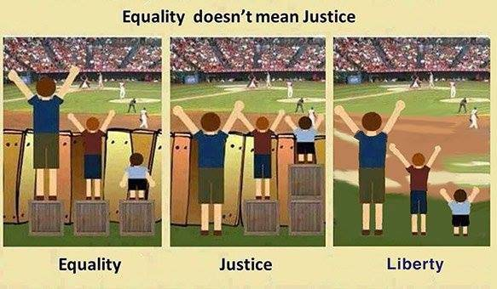
Understanding Equality, Justice & Liberty
Equality does not mean Justice

Slide 19
26 Teamwork Key Issues
10. Failure to listen, comprehend and reply
11. Distance between offices and inaccessibility
12. Cultural differences and ethnocentricity
13. Dominating personalities, attitude and ego
14. Authority, seniority or hierarchy problems
15. Poor verbal and written expression
16. Gender biasness – both for males and females
17. In-adequate knowledge but argumentative nature
18. Exceeding deadlines

Slide 20
26 Teamwork Key Issues
19. Self-centeredness and half-heartedness
20. Uncooperativeness and stubbornness
21. Mistrust
22. Risk and rewards, success and failures
23. Lack of professional skills
24. Slow progress and negative results
25. Lack of celebrations
26. Decline in motivation

Slide 21
15 Remedies of Key Issues
1. Promoting importance of listening
2. Conducting regular meetings with feedback solicitation
3. Spreading commonalities instead of differences
4. Making and announcing rational and timely decisions
5. Applying equality, justice and liberty as per requirement
6. Promoting usage of common language and connotation
7. Promoting spread of candid and credible knowledge only

Slide 22
15 Remedies of Key Issues
8. Establishing agenda and timelines to keep meetings focussed
9. Agitating habitually quiet members to take part in discussion
10. Promoting acceptance and tolerance
11. Justifying workload distribution w.r.t capacity & competence
12. Blending human skills on priority – Sympathy Vs Empathy
13. Developing selflessness and dedication
14. Developing collaboration and flexibility
15. Developing creativity, innovation & out-of-the-box thinking

Slide 23
Thanks You

